Slide 1
Tank Battle
B05901016 王珽
B05901064 林承德
B05901185 戴慕潔

Slide 2
Outline
Game Rules
Game Structure
Display
Joystick
Game State
Tank & Shell
RandomMap
Demo

Slide 3
Game Rules
1

Slide 4

START
Place your screenshot here
Press left together to start

Slide 5
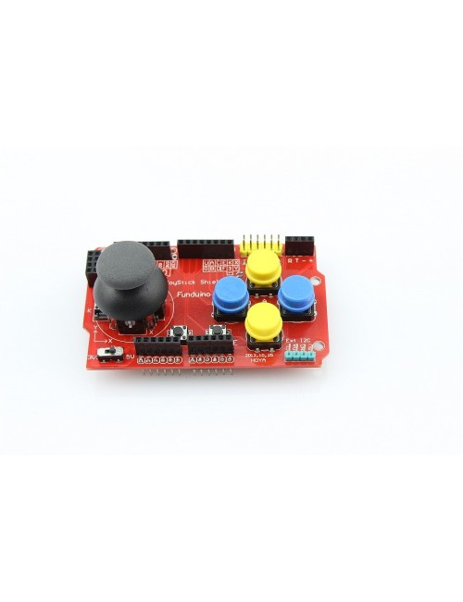
Joystick
↑
←
→
↓
Moving direction
fire

Slide 6
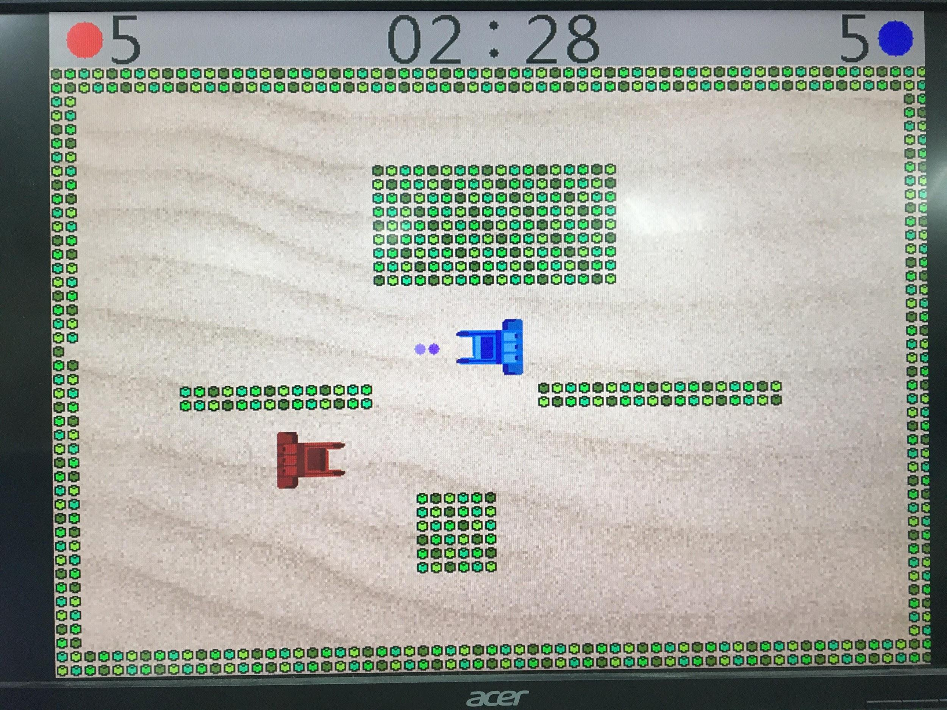
time
How many lives do you have
Player 1
Player 2
Random map
(8 maps in total)
The wall can be hit through if you hit more than 3 times

Slide 7


END
Place your screenshot here
Press left together to start the next game

Slide 8
Game Structures
2

Slide 9
DISPLAY
VGA : 640 x 480 resolution with frequency 60Hz
We divided the screen to 64 x 48 grids
Top 4 rows : Status bar
Tank : 5 x 5 grids
Shell : 1 x 1 grid
Wall : 1 x 1 grid

Slide 10
DISPLAY
K-means Clustering
k-means clustering aims to partition n observations into k clusters
We use k = 8 or 16 in this case
Reduce bits per pixel from 24 to 3 or 4.
Pros : centers are dependent on picture.

Slide 11

DISPLAY
Change color
(implement on FPGA)
Origin Image
Resize to 320x240
K-means with k=16

Slide 12







DISPLAY
Tank0_label.dat
Tank0_center.dat
Remove watermark
Coloring
Crop
Resize 50x50
K-means, k=8
Tank1_label.txt
Tank1_center.dat

Slide 13
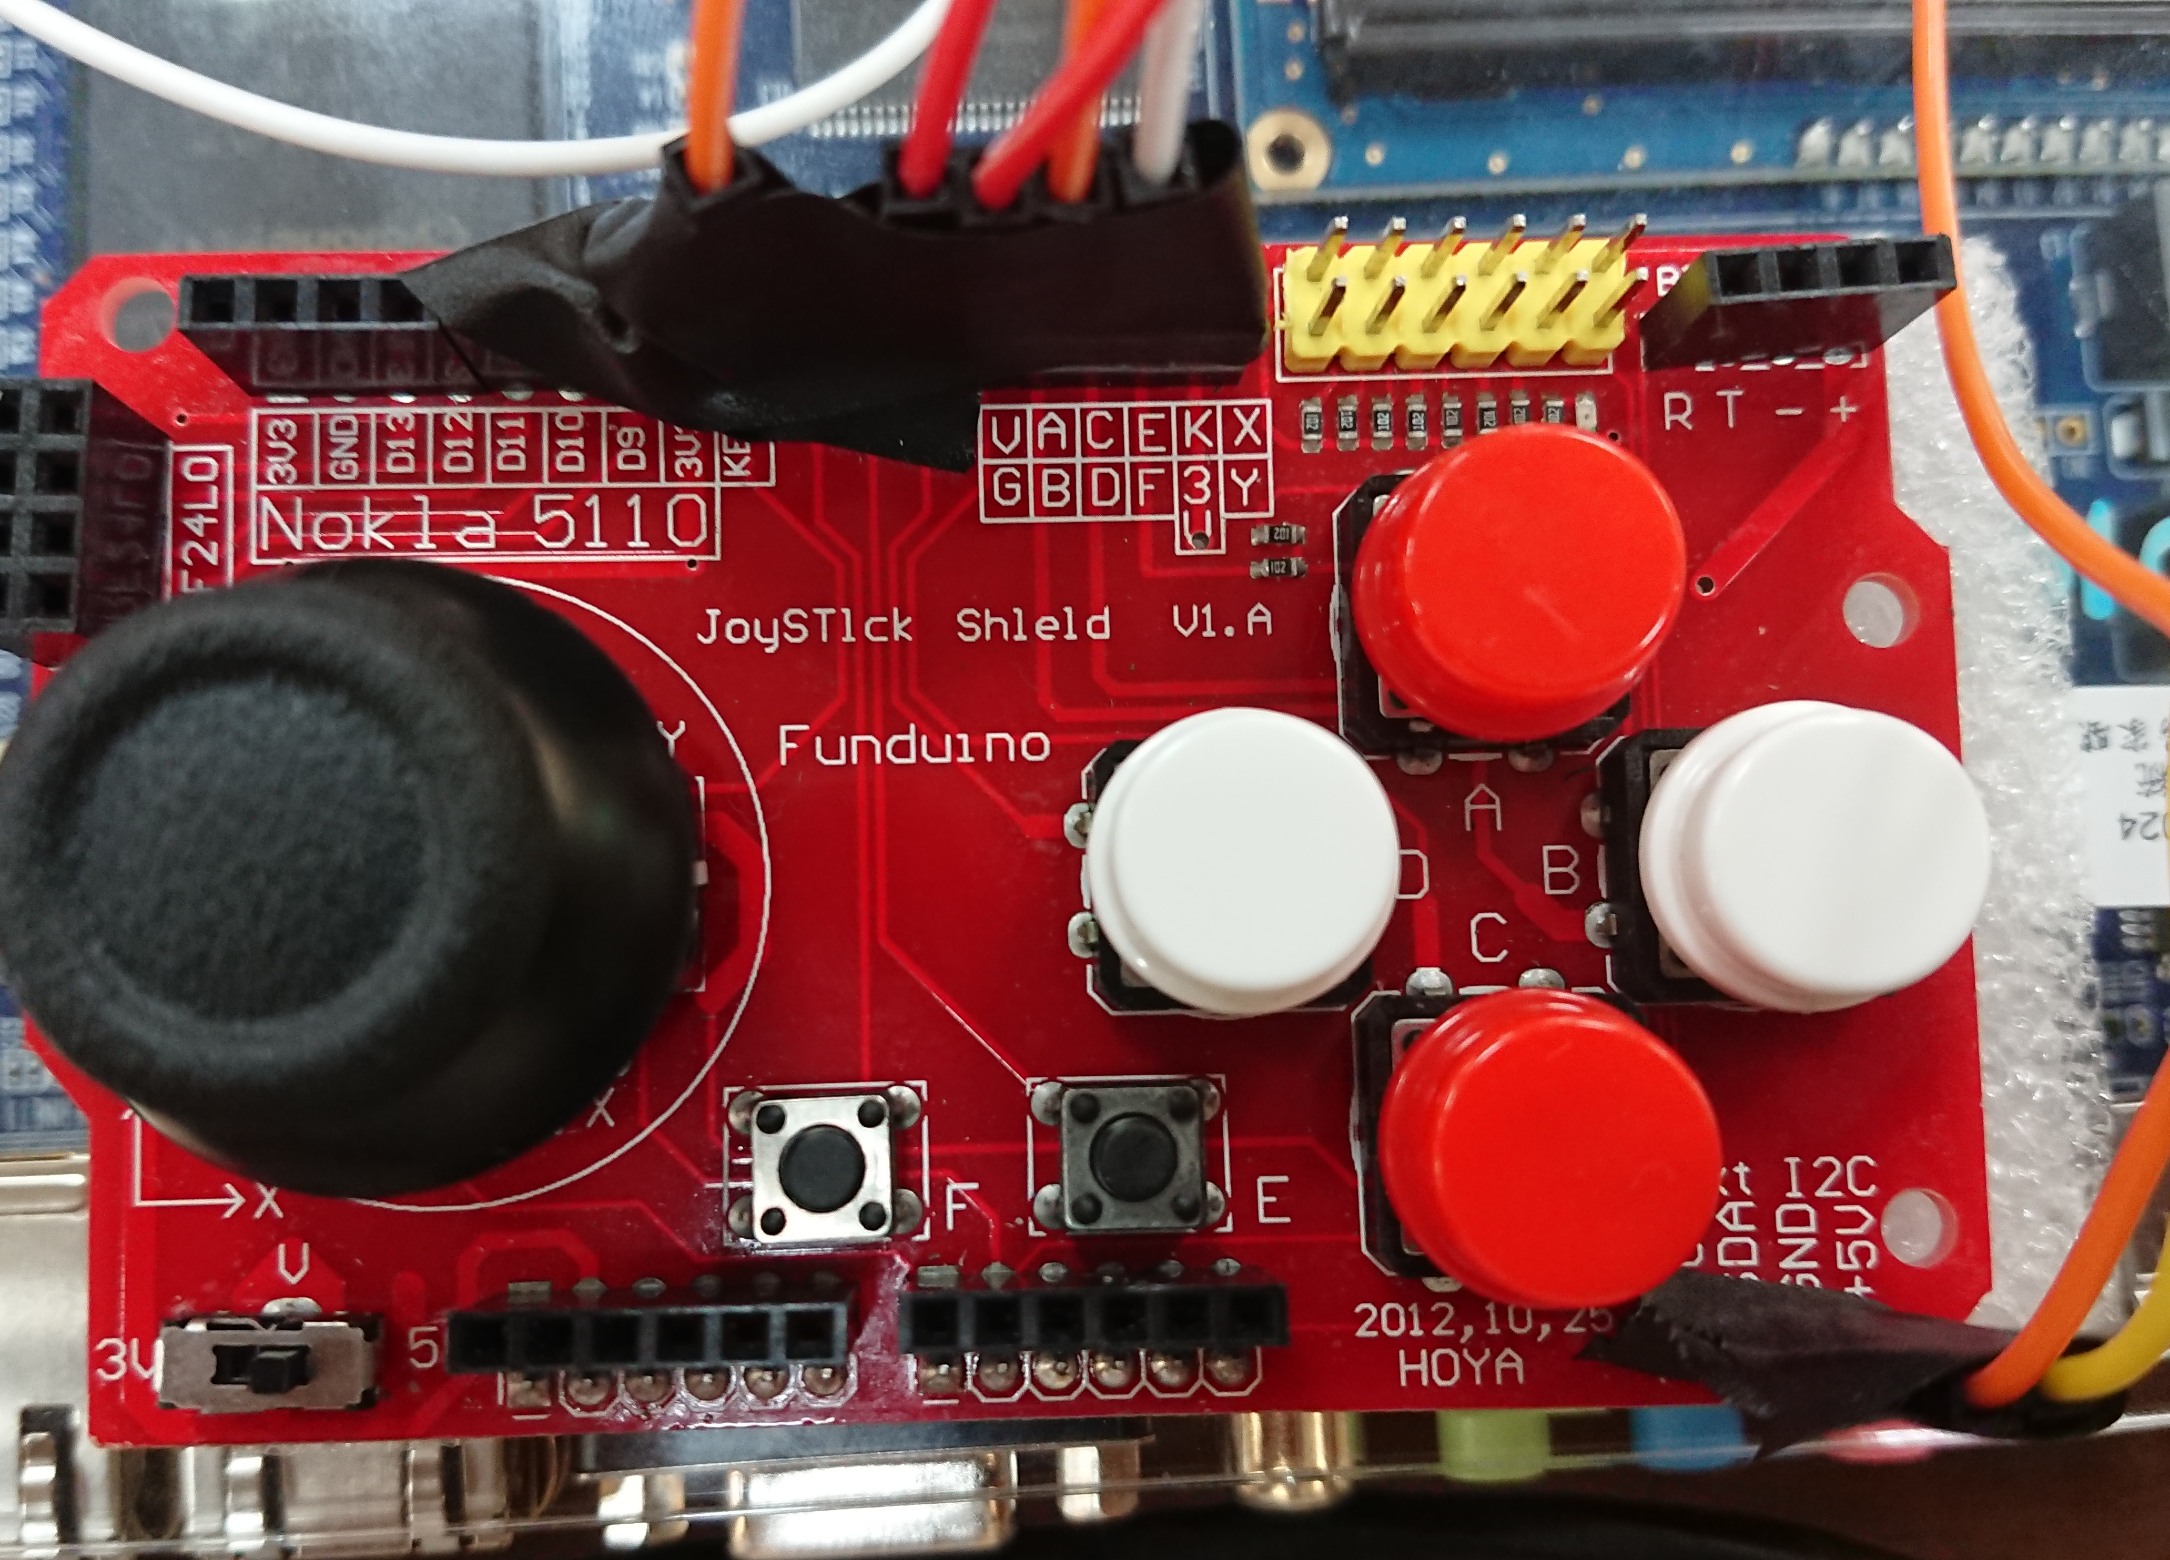
Joystick
Arduino Joystick Shield
5 buttons on it. o_debounce : up, down, left, right o_neg : fire
Connected 7 lines to GPIO on FPGA (5 buttons + VDD + GND)
Change the threshold in Debounce

Slide 14
Game States
START
Press left together
Press left together
END
GAME
Implement the collision cases:
Shell hits the wall
Tank hits the wall
Shell hits the other tank
Tank hits the other tank
One of the tanks dies

Slide 15
Tank & Shell
Position
X-position
Y-position
Speed
Tank: Change position once every four frames
Shell: Change position once every 400000 cycles
Health (Tank only)
Initial value of 3

Slide 16
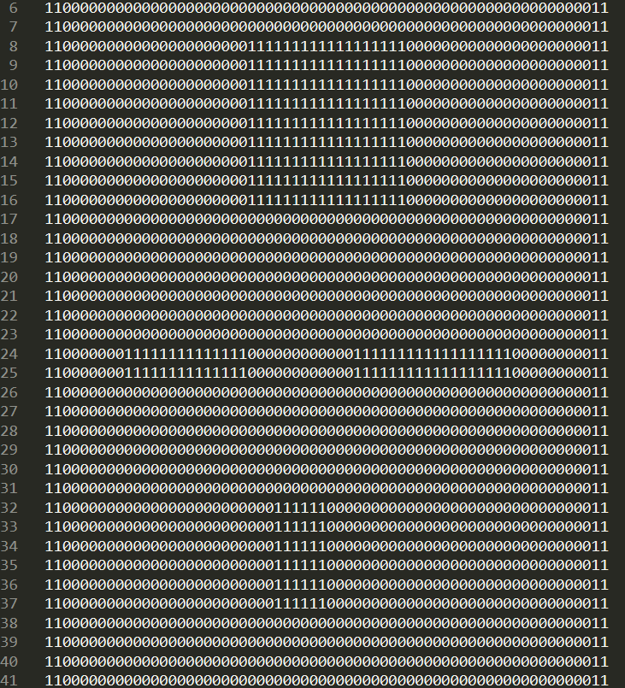
RandomMap
Provide map information to Gamestate
Random Number Generator
Use lab1’s code
RNG changes number eyery clock, but we only change map when someone dies.
Life
Initial value of 3
When the wall dies, it will send 0 to Gamestae.

Slide 17
Demo
3

Slide 18
Thanks!

